Slide 1
Automatic Street Lights

Slide 2
Abstract
The main purpose of the project is to switch ON and OFF street lights without manual operation.
By using this system energy consumption is reduced.
IR sensors take a major part in this project.
IR sensor is like our eye which detect the presence of an object.
In the present days automated systems have less manual operations ,high flexibility and accurate.
Our project is to control the switching of street lights automatically.

Slide 3
Materials used:
PHYSICAL COMPONENTS:
Thermocol sheets
Black chart
White paper
ELECTRICAL COMPONENTS:
Arduino board ,IR sensors ,breadboard ,LEDs, jumper wires.

Slide 4
Working of the project
The working of project can be explained by considering street lights.
In this project IR’s are used for sensing the vehicles.
As IR senses the vehicle ,the street lights associated w.r.t sensor will switch ON and OFF after certain time.
ADVANTAGES:
Complete elimination of manpower
Reduce energy costs.
Reduce maintenance costs.
Easy to install in offices,houses,streets.
Save energy by turning off the lights when the vehicle is not detected.
No additional wiring

Slide 5

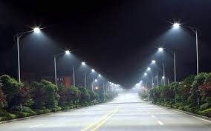
application
1.GARDEN LIGHTS 2.STREET LIGHTS

Slide 6

3.CAR PARKING LIGHTS

Slide 7
Result
The main of idea of the project is to reduce wastage of electricity.
IR sensors are used for this purpose,
The street light corresponding to that IR will switch ON automatically when a vehicle passes.

Slide 8
conclusion
Can overcome the crisis of natural power production resources in future.
Can reduce the wastage of electricity.
Smart street lighting system integrates new technologies offering ease of maintenance and energy savings.
Along with energy saving it also tackles with the problem of power theft.

Slide 9
Thank you

